Slide 1

Asaf – אסף
https://github.com/motidahari/AsafApp.git
*הריפוזיטורי פרטי מחשש לגניבת דעת, מצורף ריפוזיטורי אחר המשמש להרצה בלבד בפלטפורמת Expo:
https://github.com/motidahari/AsafApp-expo.git
*במידה ותרצו להיחשף לקוד המלא נשלח לכם אותו באופן פרטי.

Slide 2
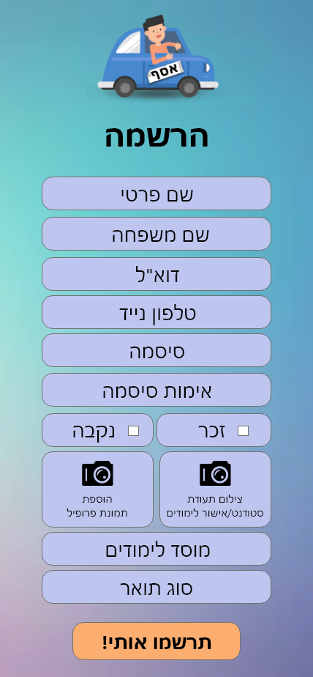
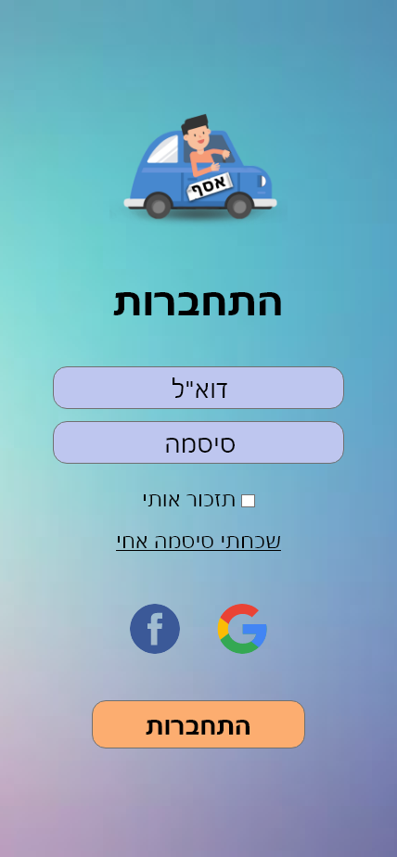
Registration AND LOGIN
Text input – validating that the user had filled out the form
Text input – masking the users password while filling the form.
Picture input – accessing the user’s camera/photo library (IOS users are asked to provide permission.
Text input – validating the length of the email address.
On click events to login using social network accounts .
Login sends request to database and awaits respond while displaying a loading component.

Slide 3
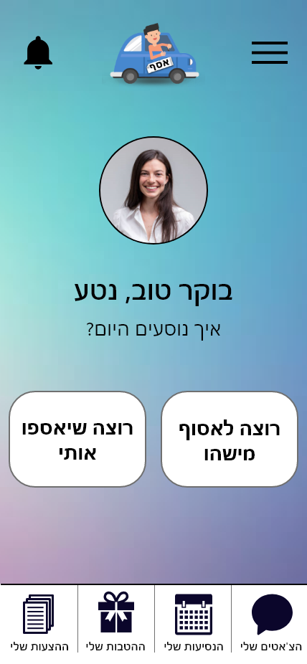
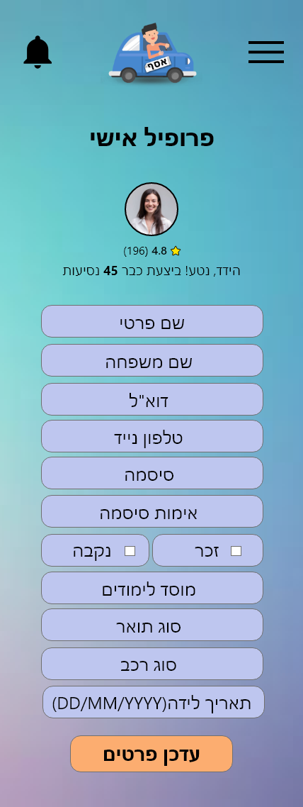
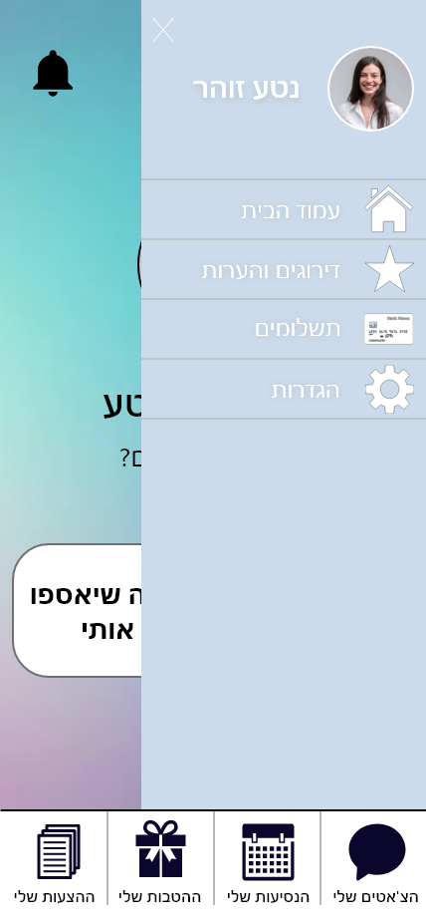
Home page and profile
Navigator button to the notifications screen part of the header as well
Navigation popup menu part of the header component to switch between screens.
Sends a request to the database to update the listing of the user.
Username and avatar are displayed with data retrieved from the database.
Each user has two behaviors, one as a driver and the other as a passenger.
Footer quick navigation bar, used across the whole app

Slide 4
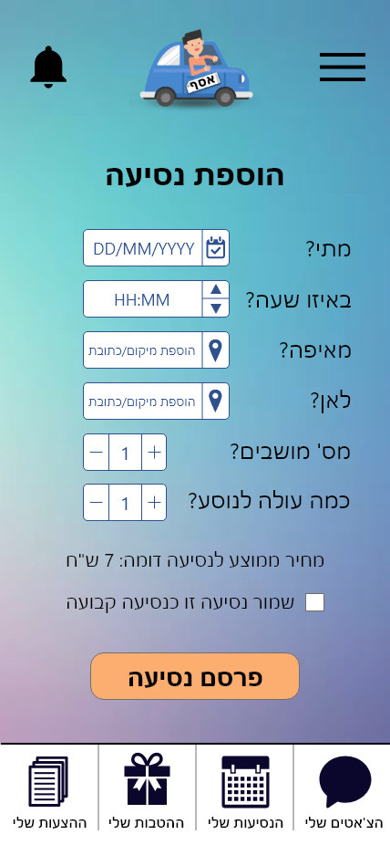
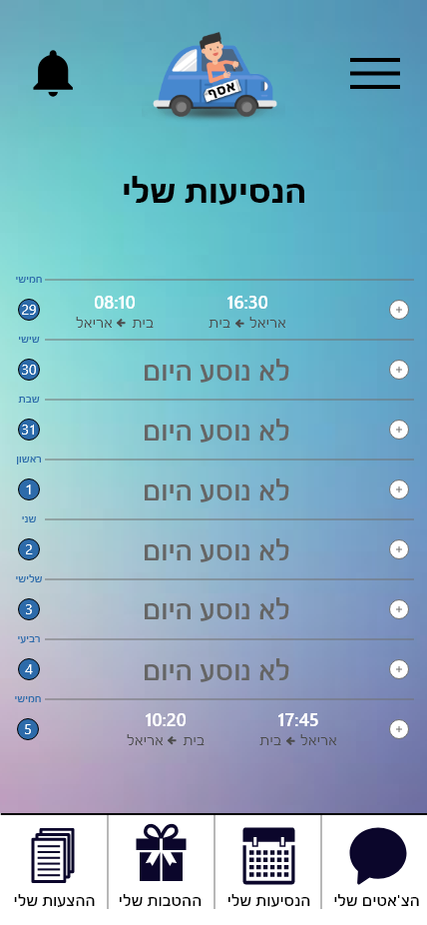
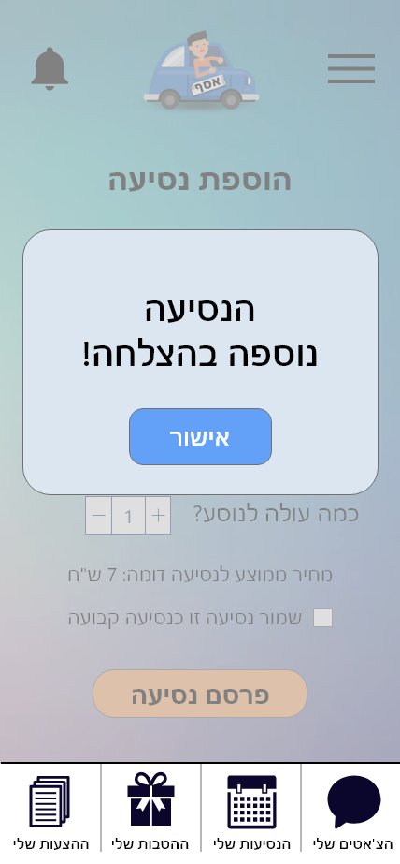
Adding new drive
Adding the drive to the specific time, date, location, num of available seats and price.
Driver can add a certain drive to be a regular route he’s taking. This will be displayed in his upcoming drives screen.
On click posts the new data to the database. After the update was inserted a success popup appears.

Slide 5
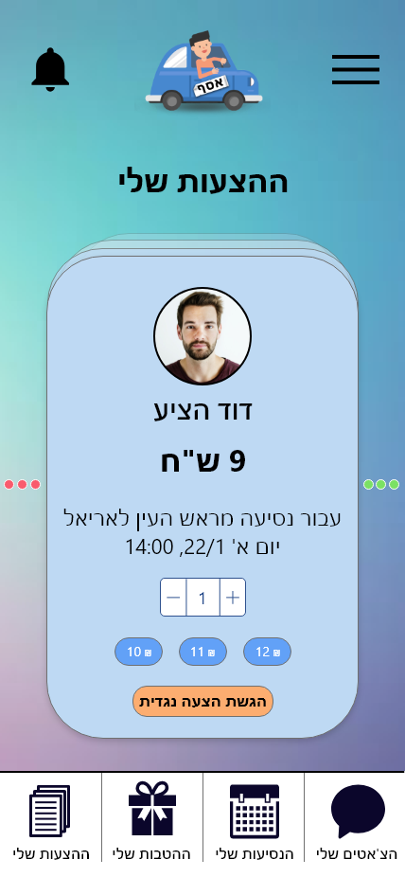
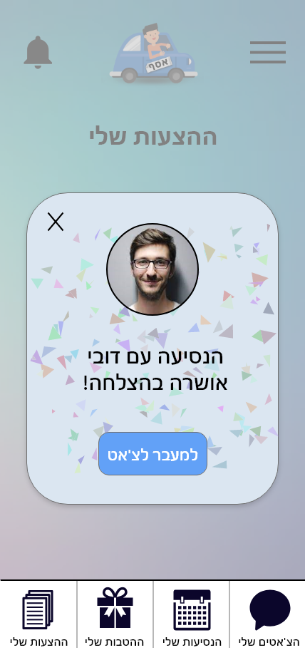
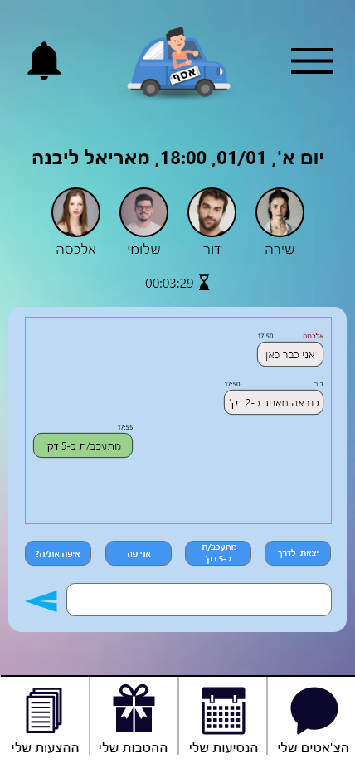
Driver suggestion screen
After adding a new drive, the driver might get counter offers from the passengers. He can accept or decline or send a new price offer.
If the driver had accepted the offer this popup will appear and will navigate to the chat which includes the driver and the passenger with him.
On click posts the new data to the database.

Slide 6
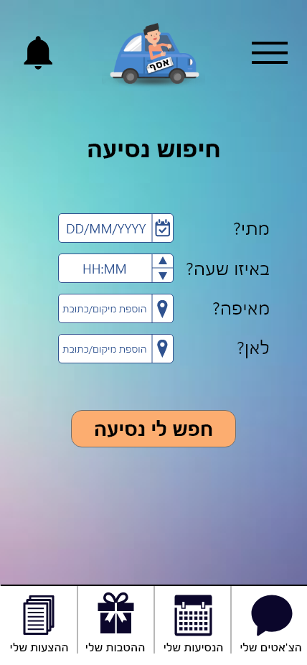
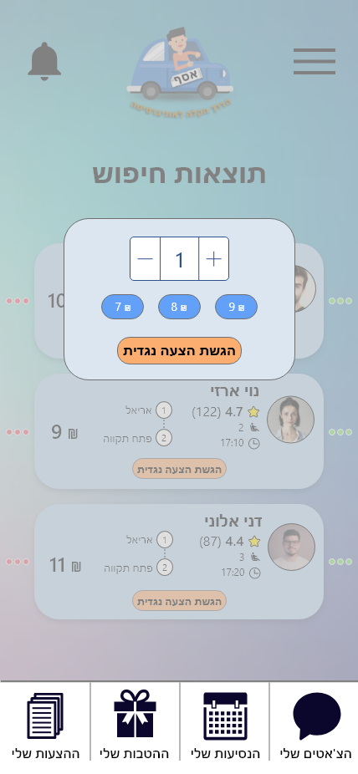
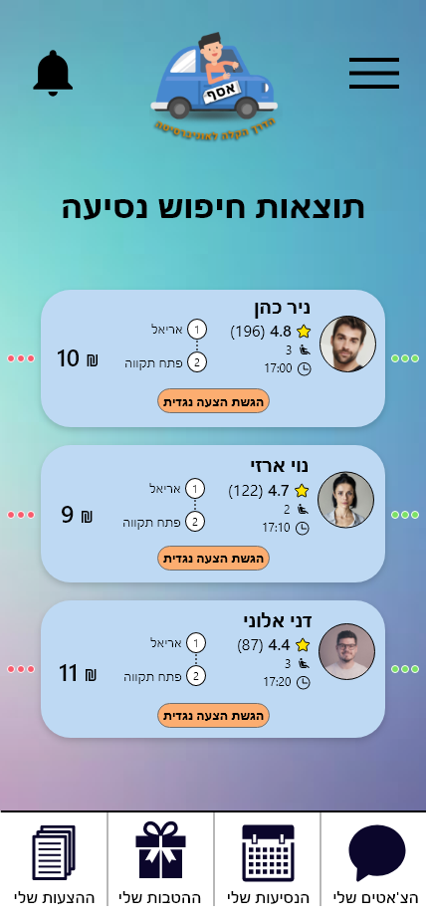
Searching a drive as a passenger
Counter offer popup allows to use a pre-calculated price (according to the driver’s price) and manually increase/decrease price.
Clicking the button in the bottom part send the request and updates the database for the driver.
Passenger's filter drives as they want.
Displays the relevant drives requested, with the time, number of seats available, driver info and price. Passenger can approve or disapprove the drive suggested.
Clicking the counter offer button will display a popup where you can send the driver a different price.
On click requests relevant drive specified to the time ,date , origin and destination requested. While displaying a loading popup.

Slide 7
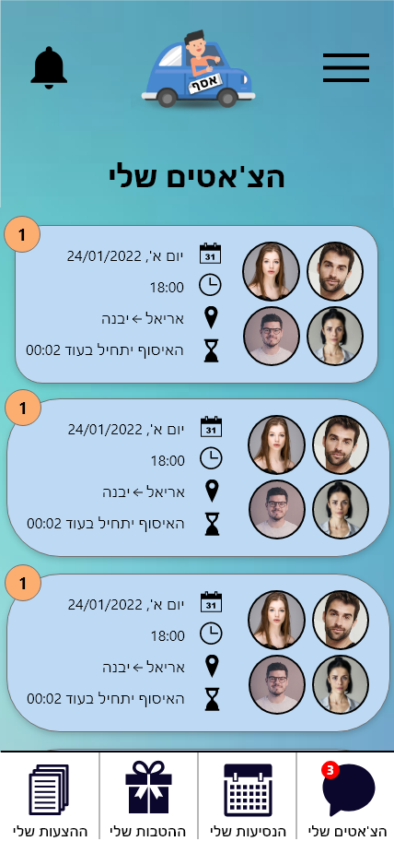
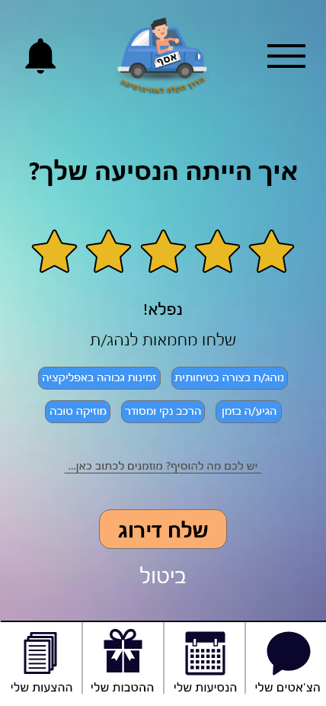
Chat screens
The chat info remains “alive” while the drive hadn’t been complete. After the drive was complete the chat will disappear from the user upcoming drives chat. After the drive was complete the passenger can leave a feedback and rating to the driver
Displays all upcoming drives that had been accepted with their information.
Displays the relevant drives requested, with the time, number of seats available, driver info and price. Passenger can approve or disapprove the drive suggested.
Message templates for quicker reply.
When sending the message a request is sent to the database to update the content of the chat and render it to the chatbox.
Each chat contains users information retrieved from the database which includes their profile information.

Slide 8
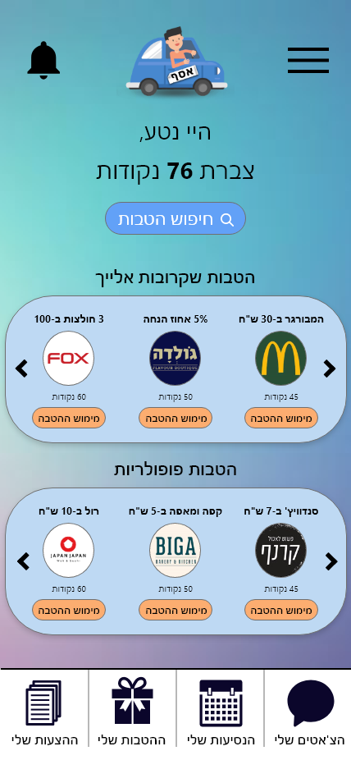
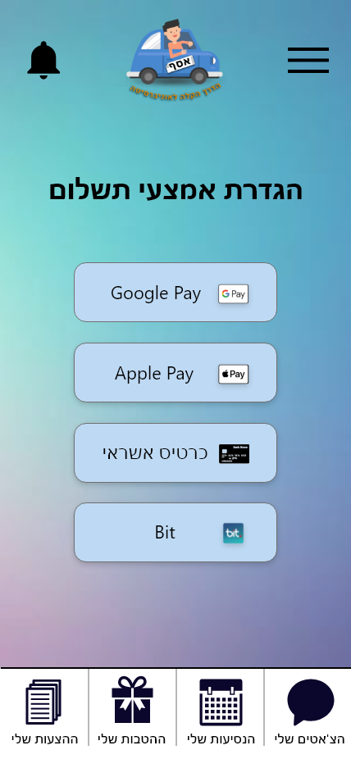
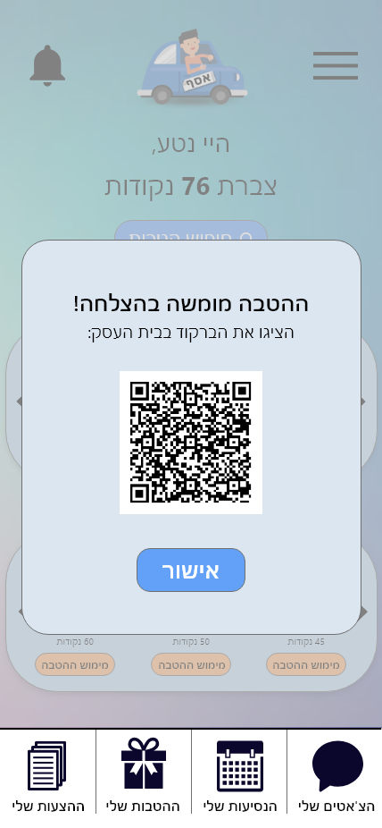
Payments coupons
Drivers and passengers collect points according to their amount of use in the application and as well as their rating being the driver/passenger.
Users can choose with which platform they would like to pay. This step still needs to be implemented to ensure the users security and better KYC guidelines.
Clicking to redeem the coupon will display a barcode popup that the user will display at the store. This sends a request to the database ensuring that the user has enough credit to redeem it and then it will display the barcode.

Slide 9
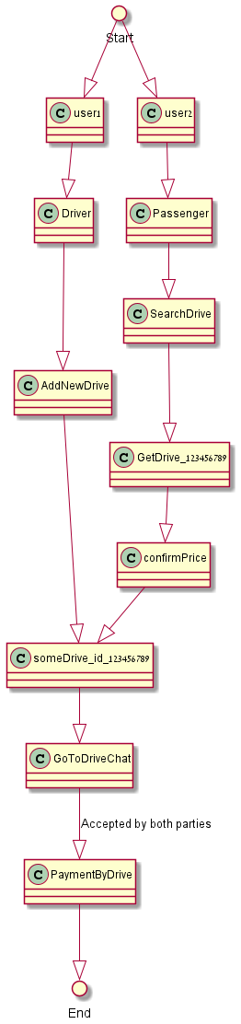
Activity Diagram

Slide 10
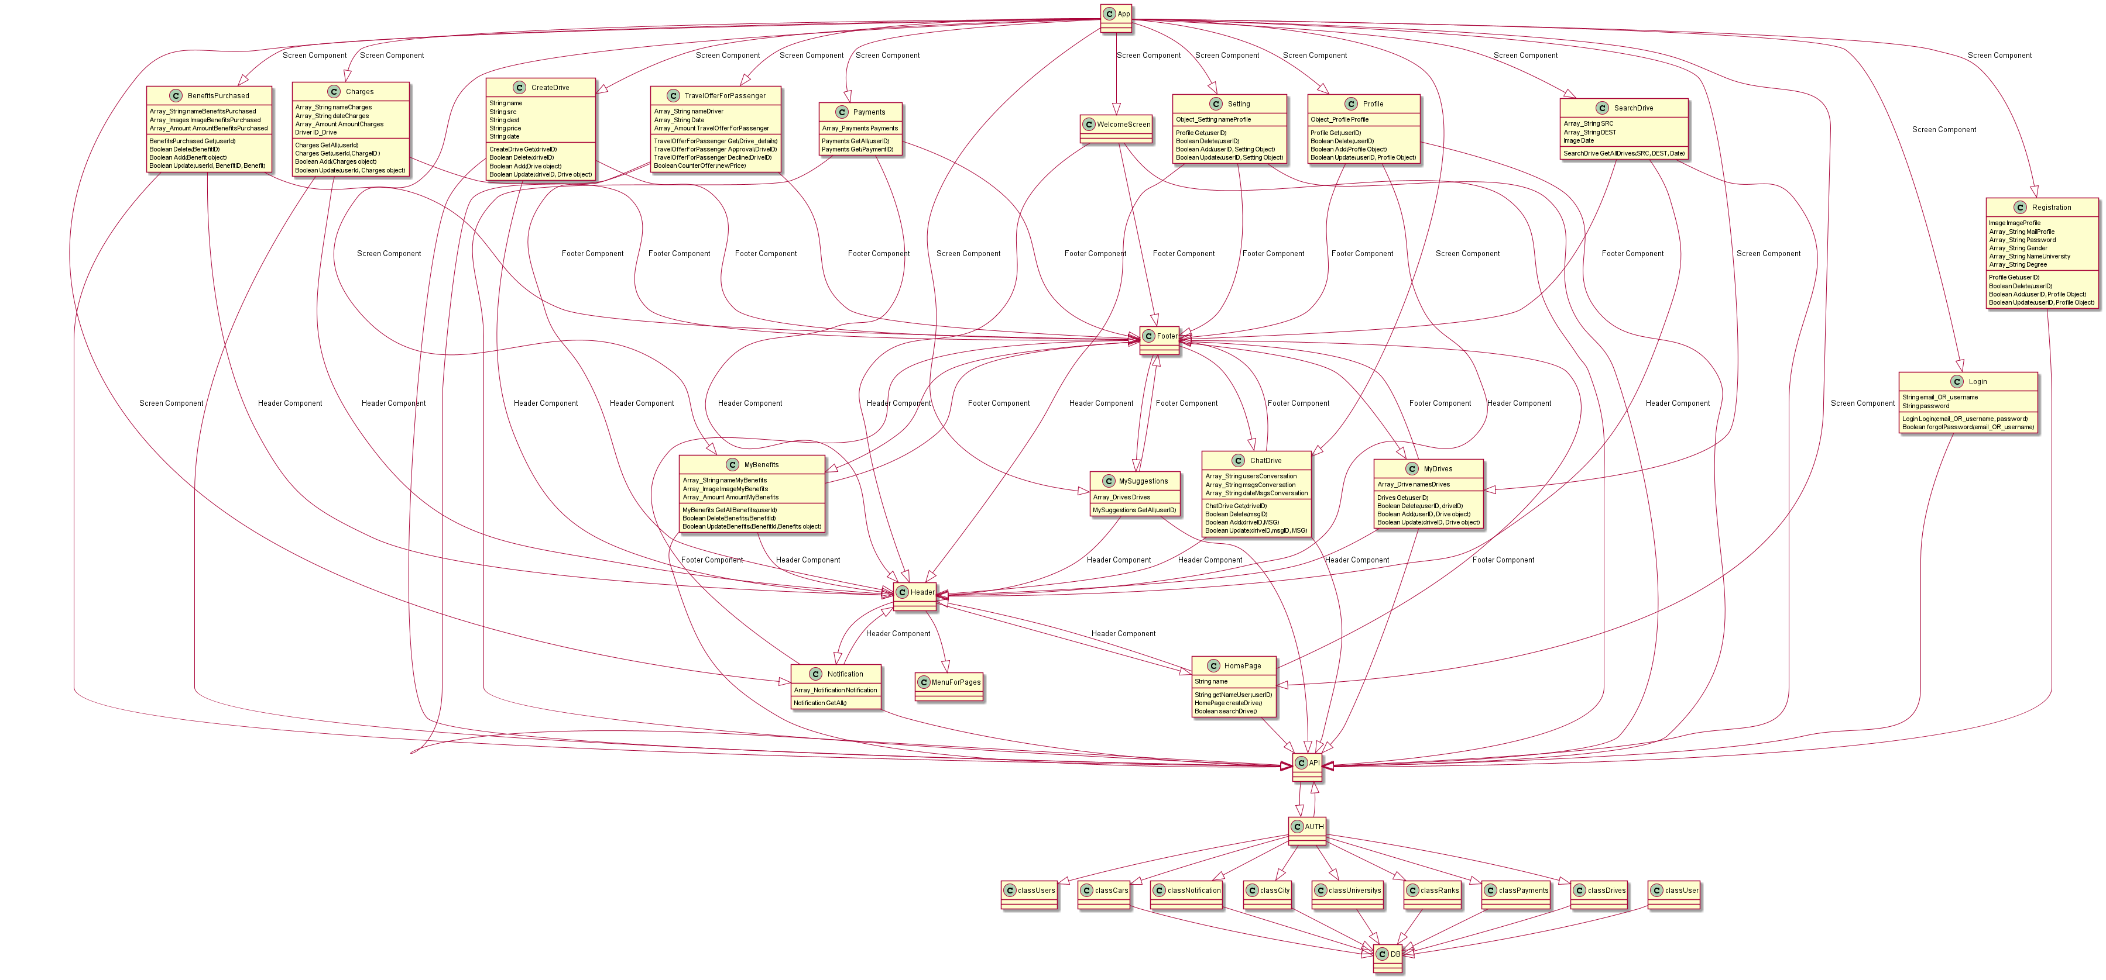
Class Diagram

Slide 11
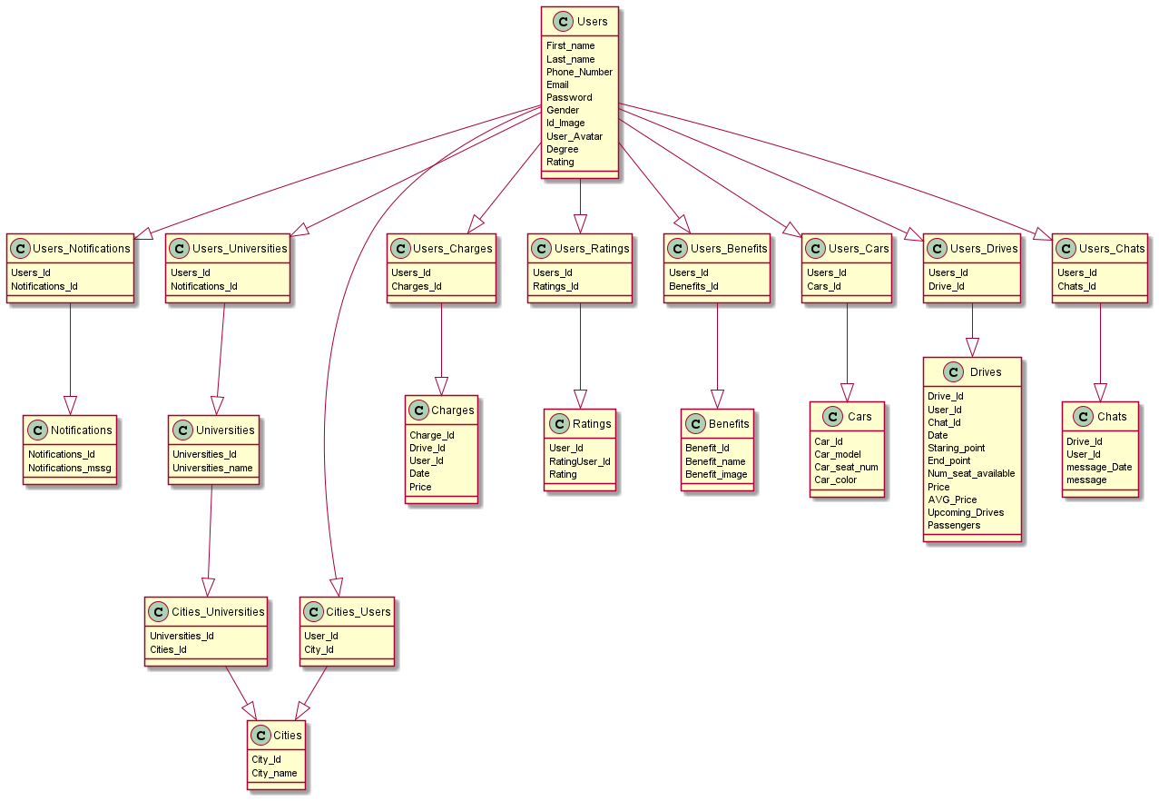
ERD Diagram

Slide 12
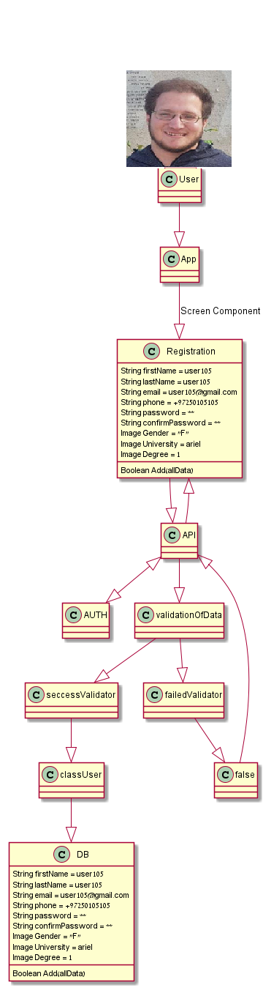
Object Diagram

Slide 13
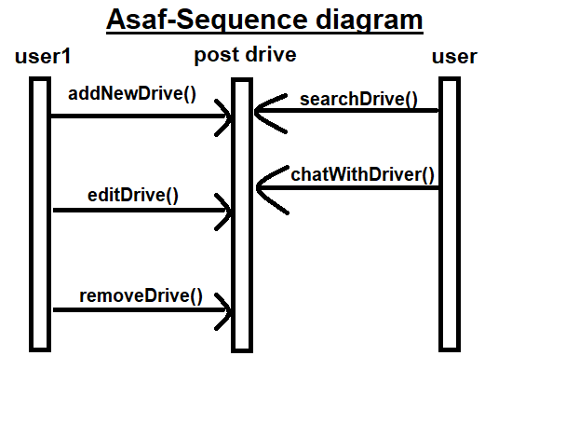
Sequence Diagram

Slide 14
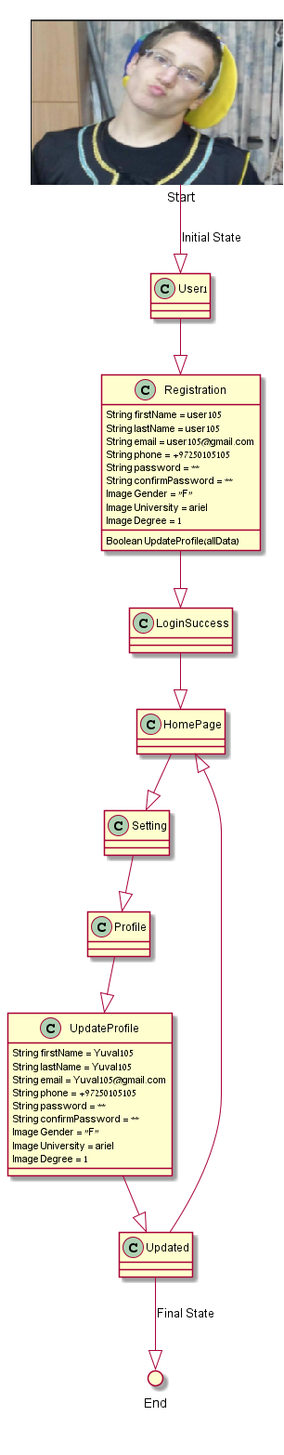
State Machine Diagram

Slide 15
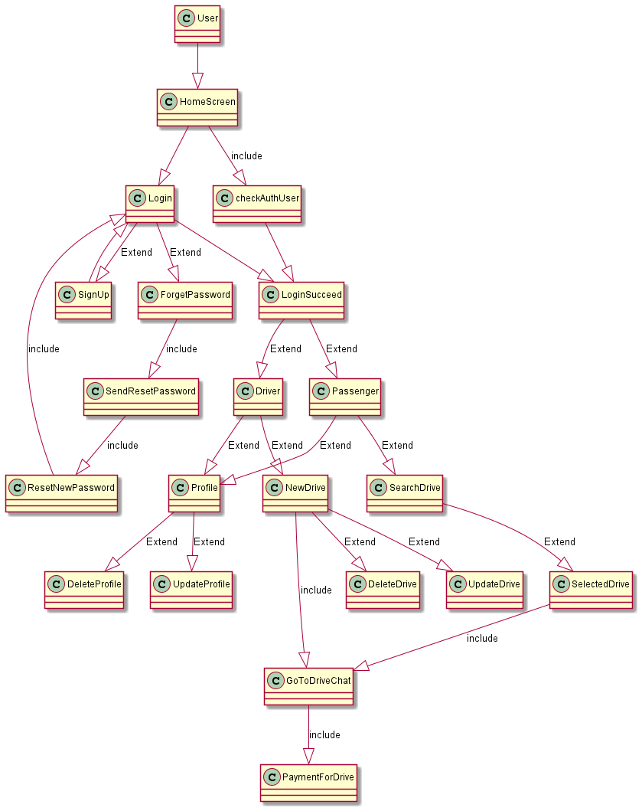
Use Case Diagram

Slide 16
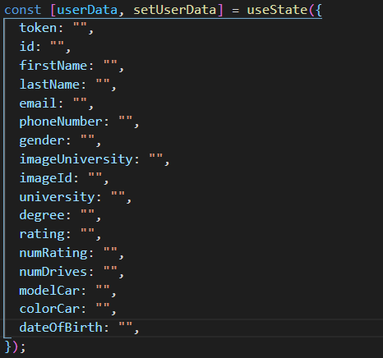
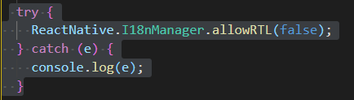
Main objects and methods in our App
The app root components in our project contain usestate which allows us to create an object and a function to set the value of the state in which the object is.
Userdata:
This state allows us to manipulate and access the user's data.
RTL/LTR:
The app configurates the layout according to left hand side or
right hand side.

Slide 17
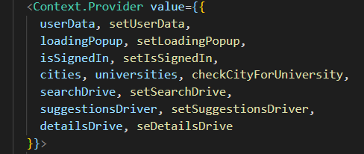
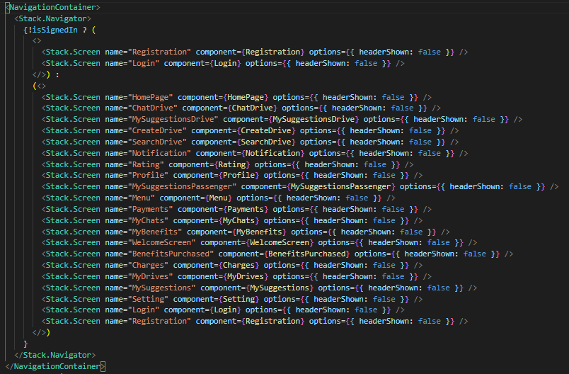
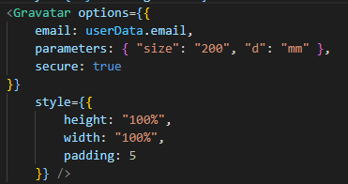
Context provider:
This hook allows us to use "global variables" in order to share their value across all child components without using them as props in the child component such as users data. isSignedIn:
this state confirms that the user logged in, in case he didn't he user will not be able to access and navigate to the rest of the screens. This allows for better data security.
Gravatar: Gravatar library allows us to access the user's profile image using his email address.

Slide 18
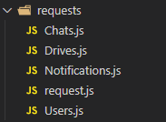
Hooks:
These hooks help us adding more functional operations and solving multiple complex problems, which involve data and app configuration. For additional information regarding hooks in react – https://reactjs.org/docs/hooks-reference.html
For example:
These const values in the homepage are retrieved from the main app component. As explained in the context provider above.
This is the core of our app data retrieval and update from our AWS server developed using NodeJS

Slide 19
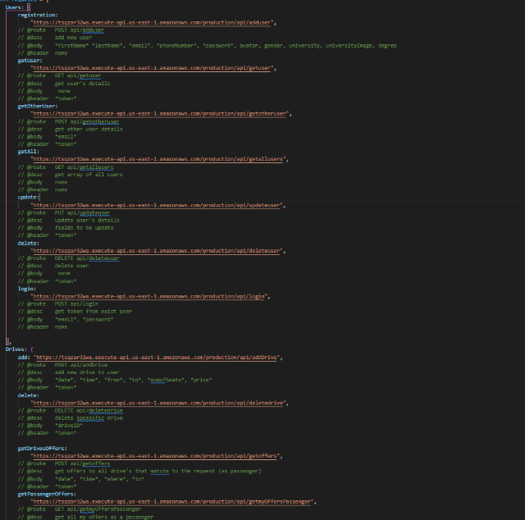
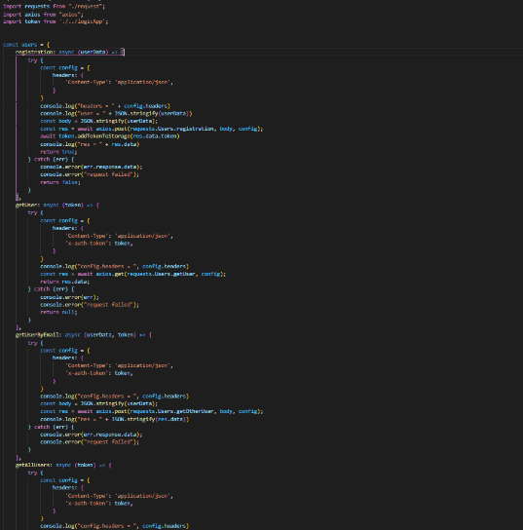
request.js :
this file is responsible for all the paths of our requests from
the server.
Users.js :
this file is responsible for the requests concerning the
user information.
Same goes to the rest of the files:
Notifications.js
Drives.js
Chats.js

Slide 20
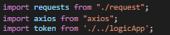
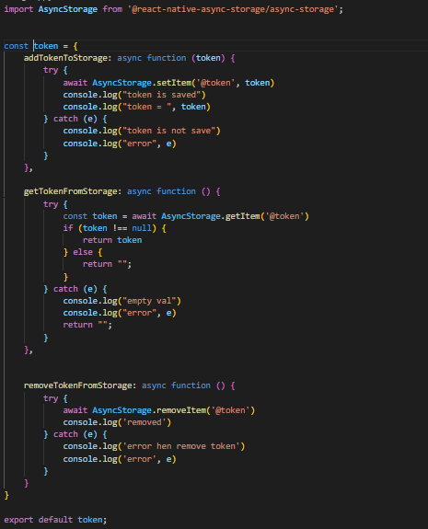
Axios is the library that allows us to send requests (GET,POST,PUT,DELETE).
Addiotnally the library includes methods to customize the header and body of the requests.
logicApp.js:
this file manages the functions which corresponds with token
related to the user. The token is used with async-storage library as a substitute
to regular sessions.
For all of our requests from the sever except on registration and
Login, we send the server the requet with the token inside the
Config header, which ensures that the request will be
excecuted if and only if the user exist and logged in to the App.

Slide 21
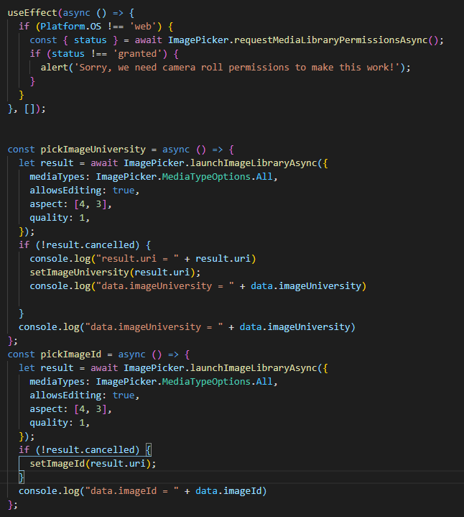
Image Picker:
Once the component (screen) is accessed the App
asks for the user's permission to access his photo gallery
and allows us to save his images in our database as a path.

Slide 22
Our project is developed using react-native and NodeJs javascript libraries and
published using expo-cli which allows:
Creating new projects
Developing your app: running the project server, viewing logs, opening your app in a simulator
Publishing your app JavaScript and other assets and managing releasing them as updates
Building binaries (APK and IPA files) to be uploaded to the App Store and Play Store
Managing Apple Credentials and Google Keystore

